Slide 1
MSc Bioinformatics - Basic R commands
Marc Henrion

Slide 2
Session 3: Basic R

Slide 3
Preliminaries
In this session we will cover basic R commands, how to read data in, write data or results to files, merge data tables, produce various data summary statistics etc. We will not cover data visualisation (later session).
Participant packs
https://github.com/gitMarcH/COM_STA621_2020
Copy of slides & some R codes.
Note
These slides have been generated by using R Markdown.

Slide 4
Installing R

Slide 5
Installing R
Visit:
https://cran.r-project.org/
https://www.rstudio.com/products/rstudio/download/ [recommended but optional] (choose RStudio Desktop)
Download version for your operating system
Follow instructions

Slide 6
What is R?

Slide 7
What is R?
A programming language / software environment for statistical computing.
Developed by Robert Gentleman and Ross Ihaka in New Zealand.
First released August 1993 (26 years old).

Slide 8
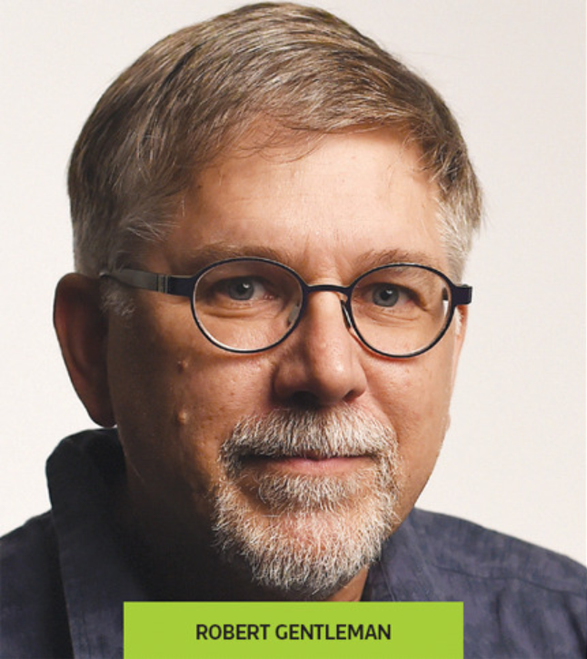
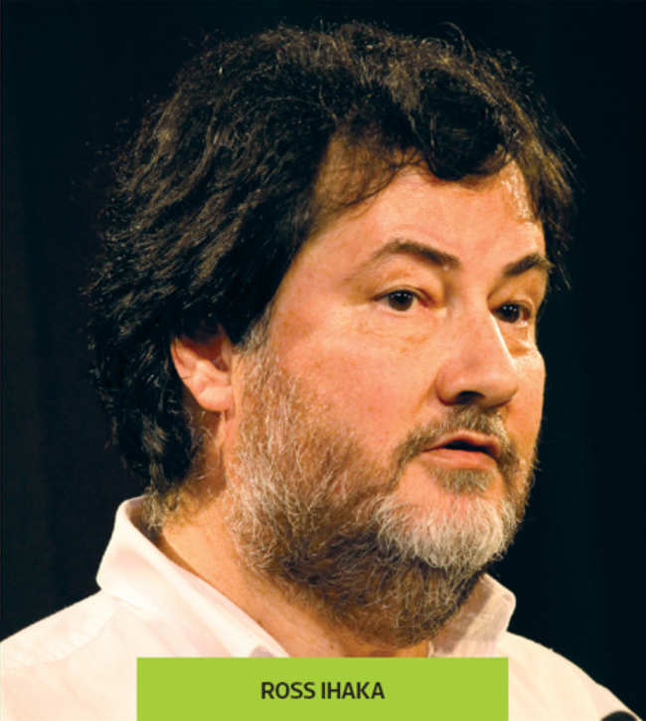
What is R?
Thieme, N., R Generation, Significance, 15 (4), 2018
Thieme, N., R Generation, Significance, 15 (4), 2018

Slide 9
What is R?
R is a multi-paradigm language:
Array [scalars generalized to vectors, matrices, higher-dimensional arrays]
Interpreted [no compiling]
Functional, impure [programming = evaluation of math functions; tell the machine what to do, not how]
Interactive mode [enter statements one at a time, see evaluation immediately]
List-based [has lists as a data structure]
Object-oriented prototype-based [classes and methods, no distinction between class and instance]
Scripting [same as interpreted; passes operations to external programs]
R is based on two older languages: S and Scheme
The name R = a nod to S and the first names of Gentleman & Ihaka
Core of R written mostly in C, Fortran and R itself

Slide 10
What is R?
Free, open source software
User could submit bug reports; frequent reporters were given permission to edit R itself
This became the R Core Team: Gentleman, Ihaka, Mächler, Dalgaard, Hornik, Leisch, Lumley, …
The Comprehensive R Archive Network (CRAN) was created to make all essential documentation and files available in one place
Kurt Hornik and Friedrich Leisch (Vienna University)
CRAN: allows users to publish custom packages – much of R’s success and functionality derives from this feature

Slide 11
What is R?
R v1.0.0 released in 2000
R adopted by data science community, phenomenal success
New generation of developers more interested in what R can do and less how it does it
E.g. Hadley Wickham of Rstudio
12,000 packages on CRAN
Even more on bioconductor and GitHub etc

Slide 12

What is R?
Thieme, N., R Generation, Significance, 15 (4), 2018

Slide 13
What is R?
2 ways of writing R code:
Classic / base R
RStudio / tidyverse
Syntax can be quite different:
tidyverse relies on a number of linked packages.
tidyverse aims for simplicity: less coding, more thinking.
Whichever is most intuitive to you, will be best for you!
Engine the same

Slide 14
Documentation & tutorials

Slide 15
Documentation & tutorials
The key to learn R is to know where to get help!
R help files
Type ? followed by the name of the command you want to get help on.
Type help.start() to open manuals, FAQs and other material.
CRAN
Tutorials & manuals:https://cran.r-project.org/manuals.html
Task views: https://cran.r-project.org/web/views/
Rstudio
Cheatsheets: https://www.rstudio.com/cheatsheets/
R-bloggers https://www.r-bloggers.com/
Stack overflow https://stackoverflow.com/questions/tagged/r
R Graph Gallery https://www.r-graph-gallery.com/
Data Camp https://www.datacamp.com/
Notes:
Programming (not just R): have idea, write code, get error, debug.

Slide 16
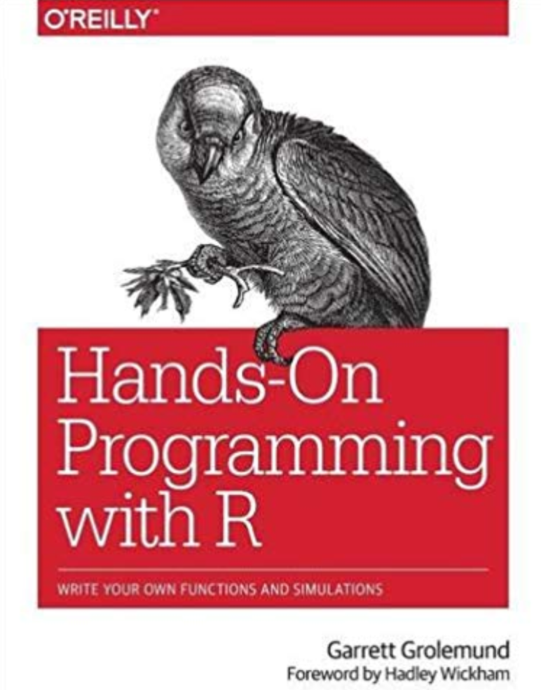
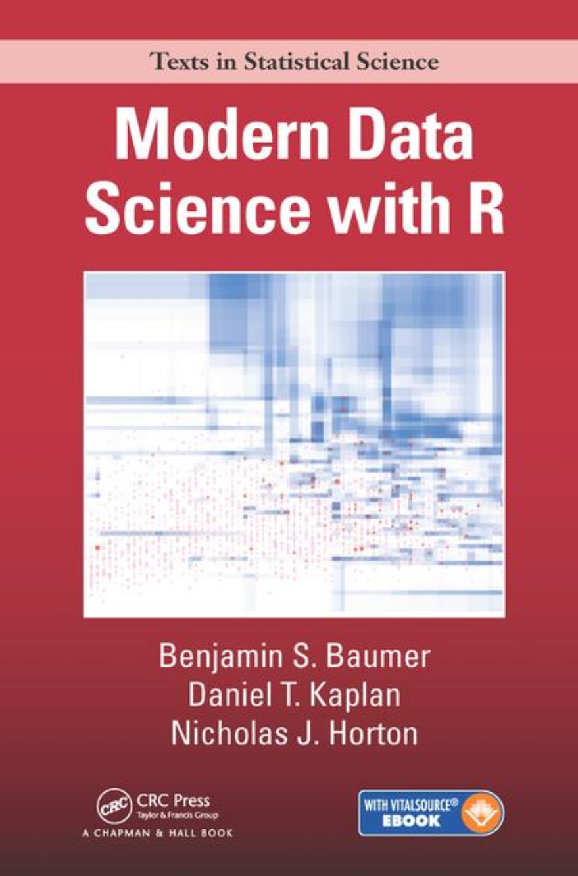
Documentation & tutorials - books

Slide 17
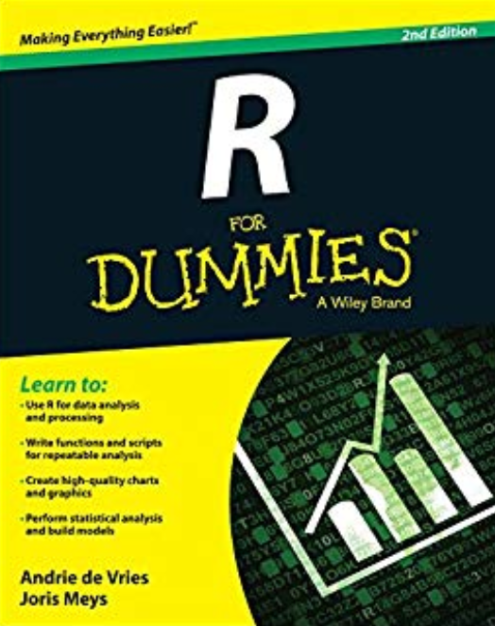
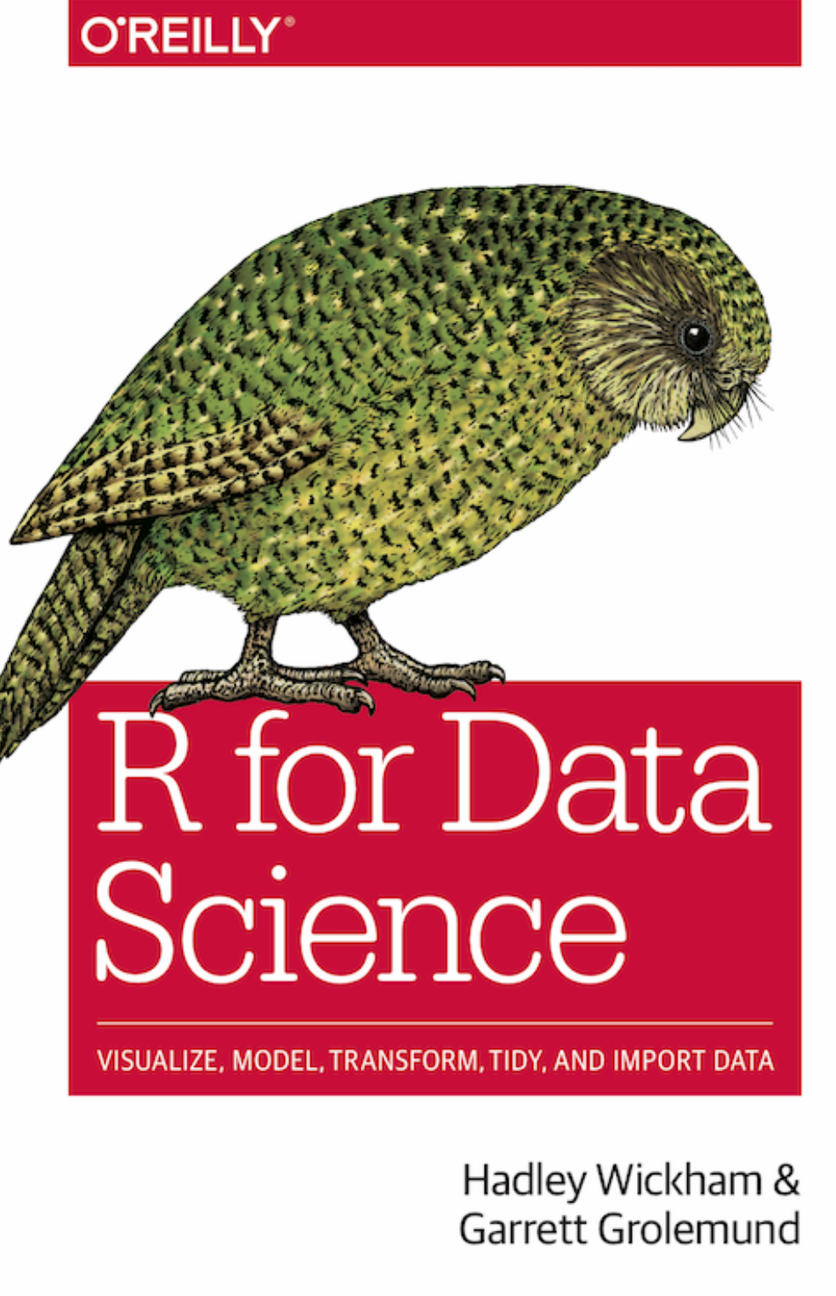
Documentation & tutorials - books
http://r4ds.had.co.nz

Slide 18
R basics
R can be just a calculator.
A standard installation of R comes with 15 core and 15 recommended packages:
Base: base, compiler, datasets, graphics, grDevices, grid, methods, parallel, splines, stats, stats4, tcltk, tools, translations, utils
Recommended: KernSmooth, MASS, Matrix, boot, class, cluster, codetools, foreign, lattice, mgcv, nlme, nnet, rpart, spatial, survival
It’s these packages, together with the many more you can install from CRAN and elsewhere that make R so powerful.

Slide 19
R basics

Slide 20
Interfaces

Slide 21
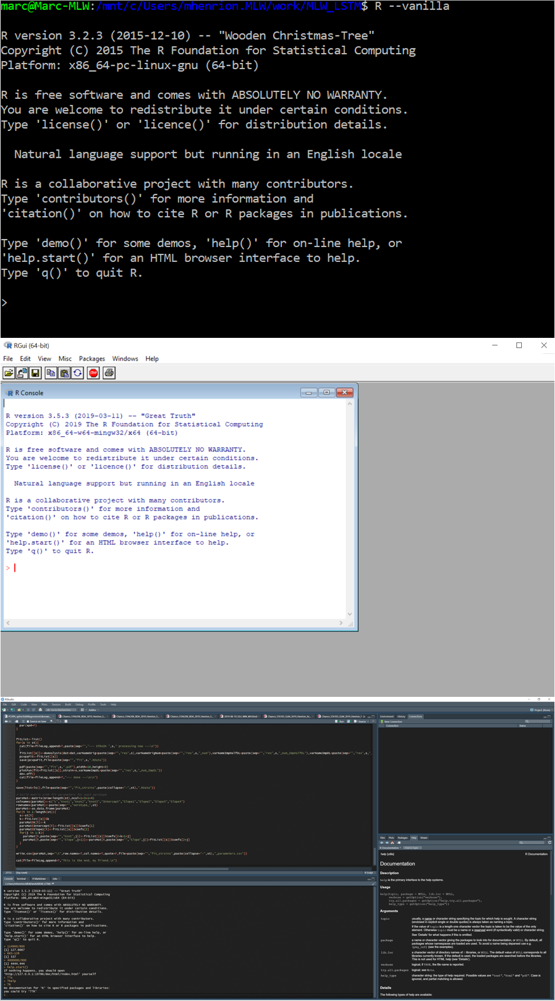
R basics - Interfaces
Console / terminal
R GUI
RStudio IDE

Slide 22
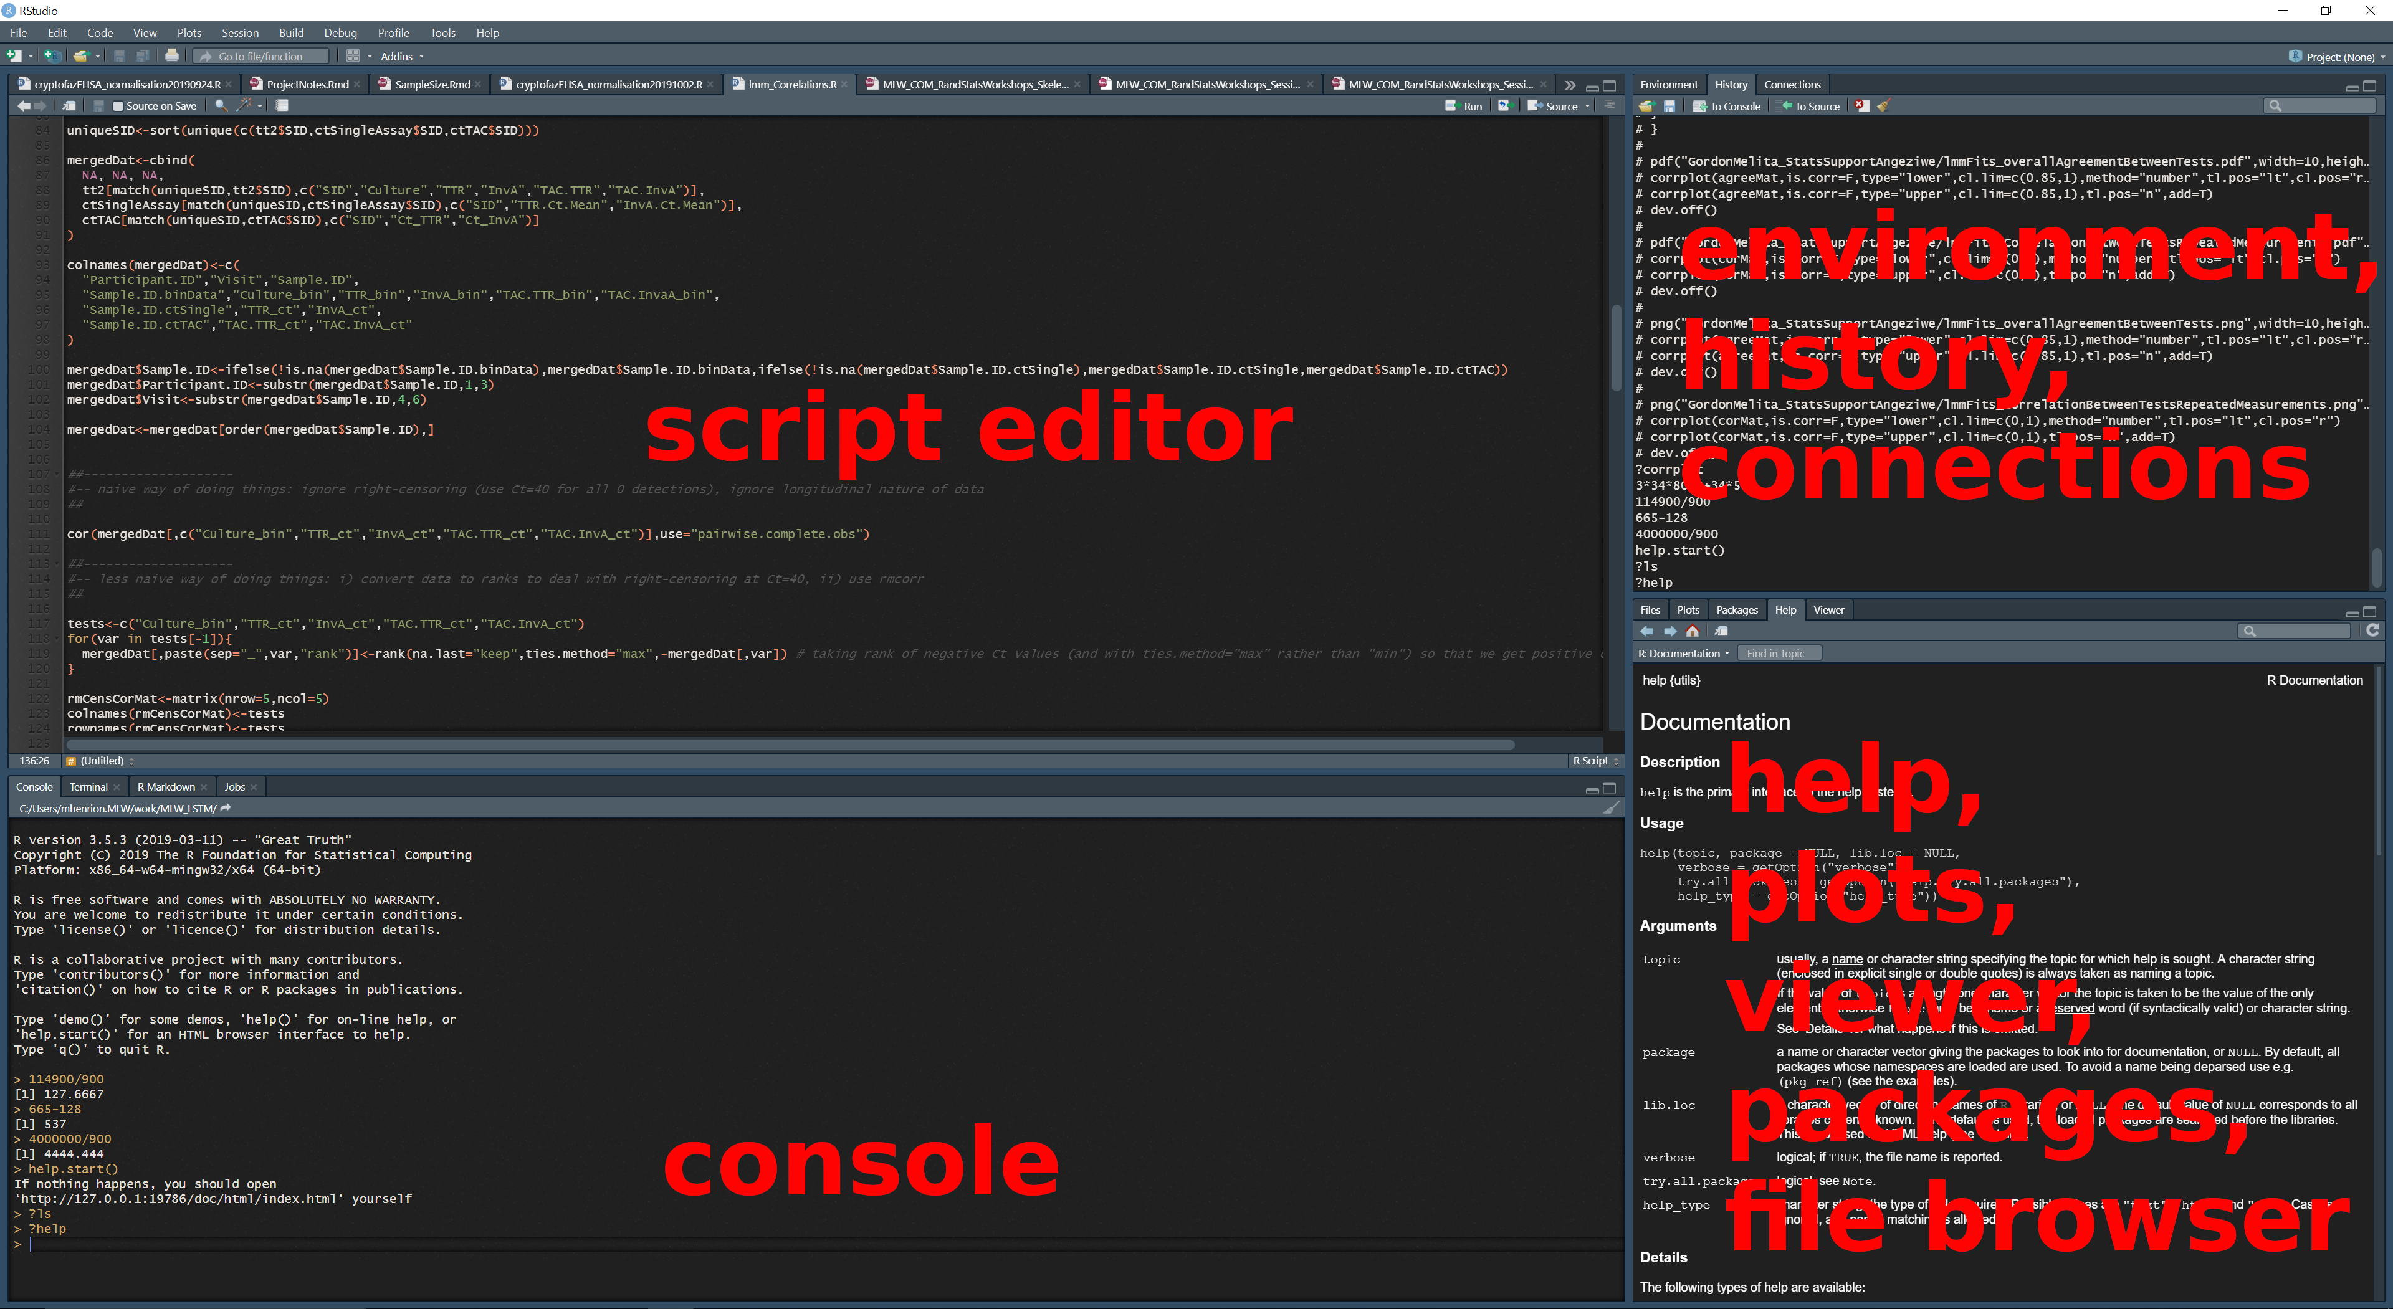
R basics - Interfaces - RStudio

Slide 23
R basics - getting started
Starting R:
Windows / Mac: start R by clicking on the R GUI or RStudio icon.
Mac / Linux: in a terminal window type R or R --vanilla (type man R at the terminal to see all options).

Slide 24
R basics - getting started
You will be able to save everything we will type into the R console by typing, at the end of the session, the following at the console: savehistory(file="RcodeFromSession1.R")
For now: open RStudio, create new project in a new directory (e.g. “RandStatsCourse”) and select
File $→$ New Project…

Slide 25
R basics - explore your environment
Display, store, change the working directory
wd<-getwd() print(wd) ## [1] "C:/Users/mhenrion.MLW/work/MLW_LSTM/Trainings/CoM/BioinformaticsMSc_Stats/2020/Session3_R-BasicCommands" setwd("../") setwd(wd)
List R objects currently in memory (this is the R workspace).
ls() ## [1] "wd"

Slide 26
R basics - explore your environment
Create directories on your hard drive from within R:
dir.create("Session3_output")
List files in different directories on your computer:
list.files() list.files("../")

Slide 27
R basics - explore your environment
If you need help or want more info regarding function arguments or exact details of what it does, type ? followed by function name:
?ls ?list.files ?dir.create ?read.table
Often most useful to directly skip to the ‘Examples’ section…

Slide 28
R basics - R packages
You will use packages – don’t reinvent the wheel.
Installing packages:
install.packages("tidyverse") # note quotation signs install.packages(c("rms","pwr"))
Loading packages:
library(tidyverse) # when using R interactively [throws error] require(rms) # for inside functions or scripts [throws warning] ## Loading required package: rms ## Loading required package: Hmisc ## Loading required package: lattice ## Loading required package: survival ## Loading required package: Formula ## ## Attaching package: 'Hmisc' ## The following objects are masked from 'package:dplyr': ## ## src, summarize ## The following objects are masked from 'package:base': ## ## format.pval, units ## Loading required package: SparseM ## ## Attaching package: 'SparseM' ## The following object is masked from 'package:base': ## ## backsolve

Slide 29
Operators

Slide 30
R basics - operators
Assignment
=, <-, <<- left assignment
->, ->> right assignment (rarely used)
Arithmetic
+ addition
- substraction
* multiplication
/ division
^ exponent
%% modulo (remainder from division)
%/% integer division
%*% matrix multiplication

Slide 31
R basics - operators
Relational
== equal to
!= not equal to
< less than
<= less than or equal
> greater than
>= greater than or equal
Logical
! logical NOT
& logical AND (element-wise)
&& logical AND (first element only)
| logical OR (element-wise)
|| logical OR (first element only)

Slide 32
R basics - operators
The above operate on vectors:
1:5 / 2
## [1] 0.5 1.0 1.5 2.0 2.5
1:5 %% 2 == 0
## [1] FALSE TRUE FALSE TRUE FALSE
1:5 < 3
## [1] TRUE TRUE FALSE FALSE FALSE
(1:5) ^ (1:5)
## [1] 1 4 27 256 3125
(1:5 %% 2 ==0) & (1:5 < 3)
## [1] FALSE TRUE FALSE FALSE FALSE

Slide 33
Common functions

Slide 34
R basics - common functions
R comes with many common functions:
mean(), sd(), var(), cov(), cor()
min(), max(), range()
median(), quantile()
sum(), prod()
log(), log2(), log10(), exp()
sqrt()
sin(), cos(), tan(), asin(), acos(), atan()
length(), dim()
is.na(), is.null(), is.nan()
rep(), seq()
...

Slide 35
Data objects / variables

Slide 36
R basics - R objects
An R object is any variable that you assign a value within R and that is stored in RAM memory.
To assign a value to an object use the <- or = operator. There is no difference between the two, but the <- operator makes it clear this is an assigment and not an equality.
a<-42 b="hello" c<-TRUE

Slide 37
R basics - data types
A variable has one of 4 levels of measurement:
nominal - classifies observations into different categories
alive / dead
human, fish, goat, bird
ordinal - different categories, but categories are ordered
low, medium, high
interval - ordered data with degree of difference; ratios not meaningful
temperature in centigrade: difference betwen 10º and 20º same as between 50º and 60º but 20º not twice as hot as 10º
ratio - interval data with a unique, non arbitrary zero value; ratios meaningful
temperature in Kelvin
length

Slide 38
R basics - data types
R supports the following data types:
Character
a<-c("male","female")
Integer
b<-1:4
Numeric / double
c<-8/11 d<-pi
Logical / boolean
e<-1:10 %% 2 == 0 f<-TRUE g<-4<2
Factor / nominal
h<-factor(sample(a,size=20,replace=T))

Slide 39
R basics - data types
Useful functions
Display data type of an object:
typeof()
Force data type change for an objecT:
as.character() as.integer() as.numeric() as.logical() as.factor()

Slide 40
R basics - data types
Useful functions
Check if an object is of a specific type:
is.character() is.integer() is.numeric() is.logical() is.factor()
Create vectors of a specific type of a given length
character() integer() numeric() logical()
Caution: factor() encodes existing variable to factor type

Slide 41
R basics - data types
Dates
These can process manually, but easier to use extra packages.
library(chron) library(lubridate) #installed with tidyverse

Slide 42
R basic - object types
Scalars
s1<-2 s2<-8/11 s3<-exp(1) s4<-sqrt(121)
Vectors:
v1<-1:4 v2<-c(s1,s2,s3,s4) v3<-rep(4,11) v4<-seq(1,10,by=1) v5<-c(21,13,37)

Slide 43
R basic - object types
Matrices
M1<-cbind(v1,v2) M2<-matrix(1:12,nrow=3,byrow=T) M3<-diag(4) M4<-v1 %*% t(v4)
Arrays
A<-table(mtcars$cyl,mtcars$gear,mtcars$am)# 3x3x2 array

Slide 44
R basic - object types
Lists
l1<-list(s1,v1,M1) l2<-strsplit(split="_", c("Deus_Phiri", "Esther_Banda"))
Data frames
df1<-as.data.frame(M2) df2<-data.frame(ID=1:3, sex=c("m","f","f"), age=v5, adult=ifelse(v5>17,1,0))
Tibbles
# requires the tibble package (installed with tidyverse) library(tibble) t1<-as_tibble(df2)

Slide 45
Reading & writing data

Slide 46
R basics - writing data
Let’s load some data:
data(iris) # not really required... ls() # new object "iris" ## [1] "a" "A" "b" "c" "d" "df1" "df2" "e" "f" "g" ## [11] "h" "iris" "l1" "l2" "M1" "M2" "M3" "M4" "s1" "s2" ## [21] "s3" "s4" "t1" "v1" "v2" "v3" "v4" "v5" "wd"
Now let’s write this to a file:
write.table(iris, file="Session3_output/iris.tab", sep="\t", row.names=F, col.names=T, quote=F)

Slide 47
R basics - writing data
Alternatively:
write.table(iris, file="Session3_output/iris.csv", sep=",", row.names=F, col.names=T, quote=F)
Or:
write.csv(iris,file="Session3_output/iris2.csv")
Or:
write_csv(iris,path="Session3_output/iris3.csv") # tidyverse / readr

Slide 48
R basics - writing data
There is even a complicated way of doing the same thing: write each line individually.
fileCon<-file("Session3_output/iris4.csv","w") cat(paste(sep="", paste(collapse=",",c(colnames(iris))),"\n"), file=fileCon) for(i in 1:nrow(iris)){ cat(paste(sep="", paste(collapse=",",iris[i,]),"\n"), file=fileCon) } close(fileCon)

Slide 49
R basics - writing data
You can also save to a binary, R format file.
This takes up less space on the hard drive and loads faster.
save(iris,file="Session3_output/iris.RData") # preserves variable name saveRDS(iris,file="Session3_output/iris.rds") # does not preserve variable name

Slide 50
R basics - reading data
Let’s read the data we just wrote to the disc back into R.
Text files
newiris<-read.table(sep="\t",header=T,"Session3_output/iris.tab") newiris2<-read.csv("Session3_output/iris.csv") newiris3<-read_csv("Session3_output/iris3.csv") # tidyverse / readr newiris4<-read_tsv("Session3_output/iris.tab") # tidyverse / readr

Slide 51
R basics - reading data
Check:
dim(iris); dim(newiris); dim(newiris2); dim(newiris3) ## [1] 150 5 ## [1] 150 5 ## [1] 150 5 ## [1] 150 5 sum(iris!=newiris) ## [1] 0 head(iris); head(newiris); head(newiris2); head(newiris3) ## Sepal.Length Sepal.Width Petal.Length Petal.Width Species ## 1 5.1 3.5 1.4 0.2 setosa ## 2 4.9 3.0 1.4 0.2 setosa ## 3 4.7 3.2 1.3 0.2 setosa ## 4 4.6 3.1 1.5 0.2 setosa ## 5 5.0 3.6 1.4 0.2 setosa ## 6 5.4 3.9 1.7 0.4 setosa ## Sepal.Length Sepal.Width Petal.Length Petal.Width Species ## 1 5.1 3.5 1.4 0.2 setosa ## 2 4.9 3.0 1.4 0.2 setosa ## 3 4.7 3.2 1.3 0.2 setosa ## 4 4.6 3.1 1.5 0.2 setosa ## 5 5.0 3.6 1.4 0.2 setosa ## 6 5.4 3.9 1.7 0.4 setosa ## Sepal.Length Sepal.Width Petal.Length Petal.Width Species ## 1 5.1 3.5 1.4 0.2 setosa ## 2 4.9 3.0 1.4 0.2 setosa ## 3 4.7 3.2 1.3 0.2 setosa ## 4 4.6 3.1 1.5 0.2 setosa ## 5 5.0 3.6 1.4 0.2 setosa ## 6 5.4 3.9 1.7 0.4 setosa ## # A tibble: 6 x 5 ## Sepal.Length Sepal.Width Petal.Length Petal.Width Species ## <dbl> <dbl> <dbl> <dbl> <chr> ## 1 5.1 3.5 1.4 0.2 setosa ## 2 4.9 3 1.4 0.2 setosa ## 3 4.7 3.2 1.3 0.2 setosa ## 4 4.6 3.1 1.5 0.2 setosa ## 5 5 3.6 1.4 0.2 setosa ## 6 5.4 3.9 1.7 0.4 setosa

Slide 52
R basics - reading data
Text files
read.table() and read.csv() determine the number of columns from looking at the first 5 lines of data; if not all rows have the same number of columns:
Specify number of columns via col.names argument.
Use fill=T if incomplete line in data (careful though with this).
read.table() and read.csv() will result in a data frame with data types for columns guessed from looking at what values each column contains; can specify these explicitly with the colClasses=c("numeric","character","factor","integer",...) argument; also by default all character columns will be converted to factors – use stringsAsFactors=F if this is not desired.
read_csv() and read_tsv() only look at first 1000 rows to guess column types.
read_csv() and read_tsv() have the col_types argument to specify column types manually.

Slide 53
R basics - reading data
Text files
read.table() and read.csv() call scan()
Can use scan() directly; this can be faster.
In general: scan() and readLines() are the basic blocks to read text files, but you will need to process (i.e. split into columns etc) the content of each line manually.
This can be convenient for large files, when you do not want / are not able to read the whole file into memory all at once.

Slide 54
R basics - reading data
Other formats
library(foreign)
Stata (up to Stata 12 dta format)
SPSS
Epi Info
Minitab
Octave / Matlab
…
Stata dta format versions can be painful
library(readstata13)

Slide 55
R basics - reading data
Other formats
Excel and other spreadsheets
Tricky: several sheets, formulae, macros, …
Best: export as text file
Otherwise:
library(xlsx) library(XLConnect) library(readxl)
Can also write Excel formats:
library(xlsx) library(dataframes2xls) # xls only library(WriteXLS) # xls only

Slide 56
R basics - reading data
Relational databases
Front-end + database management system (DBMS) specific back-end:
library(DBI) # front-end
library(RMySQL) # back-end library(ROracle) # back-end library(RPostgreSQL) # back-end library(RSQLite) # back-end
Interact with any open database connectivity DBMS:
Very versatile
Same R code for different database systems
library(RODBC)

Slide 57
R basics - reading data
Binary data formats
load() for saved workspaces and objects saved using save(). Object names in R will be the same as when they were saved, no object assignment:
load("Session3_output/iris.RData")
readRDS() for objects saved using saveRDS(). Need to assign to an object:
obj<-readRDS("Session3_output/iris.rds")

Slide 58
R basics - reading data
Image data – yes images are just data
Bitmaps
library(bmp) read.bmp()
PNG
library(png) readPNG() writePNG()
JPEG / JPG
library(jpeg) readJPEG() writeJPEG()

Slide 59
R basics - reading data
img<-readPNG("images/Rlogo.png")
img[1:2,1:4,1] # red channel ## [,1] [,2] [,3] [,4] ## [1,] 0.01176471 0.01176471 0.01176471 0.01176471 ## [2,] 0.01176471 0.01176471 0.01176471 0.01176471
img[1:2,1:4,2] # green channel ## [,1] [,2] [,3] [,4] ## [1,] 0.02745098 0.02745098 0.02745098 0.02745098 ## [2,] 0.02745098 0.02745098 0.02745098 0.02745098
img[1:2,1:4,3] # blue channel ## [,1] [,2] [,3] [,4] ## [1,] 0.05098039 0.05098039 0.05098039 0.04705882 ## [2,] 0.05098039 0.05098039 0.05098039 0.04705882
img[1:2,1:4,4] # alpha channel ## [,1] [,2] [,3] [,4] ## [1,] 1 1 1 1 ## [2,] 1 1 1 1

Slide 60
R basics - reading data
d<-dim(img) plot(c(1,d[1]),c(1,d[2]),type="n",axes=F,xlab="",ylab="",asp=1) for(i in 1:d[1]){ for(j in 1:d[2]){ points(j,d[2]-i+1,col=rgb(img[i,j,1],img[i,j,2],img[i,j,3]),pch=15,cex=3) } }

Slide 61


Slide 62
Working with R variables / data objects

Slide 63
R basics: handling data
Create and combine vectors: c(), rep()
v6<-c(14,89) v7<-rep(v6,3) v8<-c(0,v7) v9<-c("Chimwemwe","Grace","Elvis")
Join vectors, matrices, data frames and add variables: cbind(), rbind(), data.frame(), mutate(), transmute()
M5<-cbind(1:length(v9),v9) M6<-rbind(c(0,"Chimwemwe"),M5) df3<-data.frame(ID=1:length(v9),name=v9) irisNewCol<-cbind(iris,iris$Sepal.Length/iris$Petal.Length) irisNewCol2<-mutate(iris, # tidyverse; base R equivalent is transform() LRatio=Sepal.Length/Petal.Length, WRatio=Sepal.Width/Petal.Width) irisNewCol3<-transmute(iris, # tidyverse LRatio=Sepal.Length/Petal.Length, WRatio=Sepal.Width/Petal.Width)

Slide 64
R basics: handling data
Extract rows
M6[2:4,]; M6[-1,]; M6[,2] df2[df2$sex=="f",] iris[iris$Species=="setosa",] iris[which(iris$Species=="setosa"),] iris[match("setosa",iris$Species),] iris %>% filter(Species=="setosa") subset(iris, Species=="setosa") iris[iris$Petal.Length>5 & iris$Petal.Length<6,]

Slide 65
R basics: handling data
Extract columns
iris[,colnames(iris)=="Petal.Length" | colnames(iris)=="Petal.Width"] iris[,is.element(el=colnames(iris), set=c("Petal.Length","Petal.Width"))] iris %>% select(Petal.Length,Petal.Width) subset(iris, select=c("Petal.Length","Petal.Width")) iris[,grepl(colnames(iris),pattern="Species")] iris$Species

Slide 66
R basics: handling data
Extract both rows and columns
iris[1:5,c(1,3,5)] subset(iris, Species=="setosa", select=c("Petal.Length", "Petal.Width"))

Slide 67
R basics: handling data
Joins
Combining data from different tables:
inner_join() left_join() # almost always what you want to do right_join() outer_join() # tidyverse; similar to SQL
merge() # classic R # which join specified by all.x=T/F, all.y=T/F
You can manually join tables: you need to use rbind(), cbind(), match() a lot… [not recommended]

Slide 68
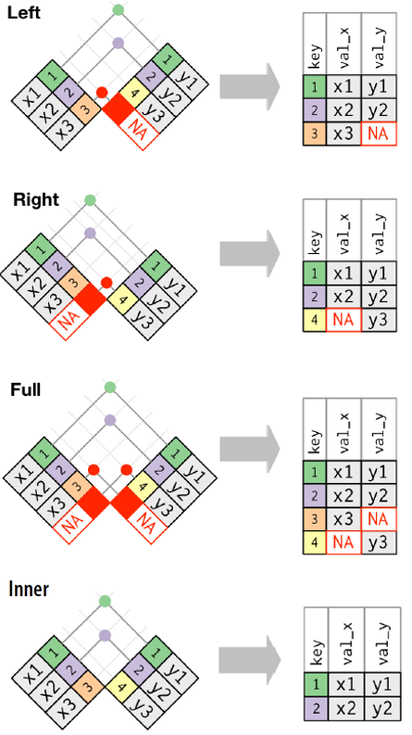
R basics: handling data
Wickham, H. & Grolemund G., R for Data Science, O’Reilly, 2016

Slide 69
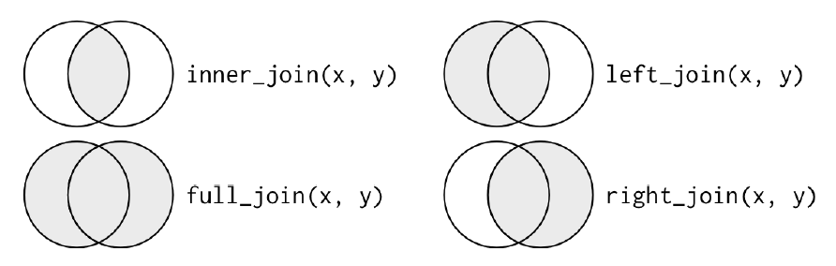
R basics: handling data
Wickham, H. & Grolemund G., R for Data Science, O’Reilly, 2016

Slide 70
R basics: handling data
Some more joins:
semi_join(x,y) # keeps all observations in x that have a match in y anti_join(x,y) # drops all observations in x that have a match in y

Slide 71
R basics: handling data
Set operations
intersect() union() setdiff()
These work not just on vectors, but on data frames too.
Try it:
v10<-1:6 v11<-5:10 df1<-data.frame(x=1:2,y=c(1,1)) df2<-data.frame(x=c(1,1),y=1:2)
intersect(v10,v11) setdiff(df2,df1) union(df1,df2)

Slide 72
R basics: handling data
Repeated measurements: wide & long formats
datWide <- read.table(header=TRUE, text=' subject sex control cond1 cond2 1 M 7.9 12.3 10.7 2 F 6.3 10.6 11.1 3 F 9.5 13.1 13.8 4 M 11.5 13.4 12.9 ') datWide$subject <- factor(datWide$subject)
This is the wide format: 1 individual per row, multiple observations of the same variable under different conditions or fixed timepoints.

Slide 73
R basics: handling data
Wide to long: gather()
datLong <- gather(datWide, key="condition", value="measurement", control, cond1, cond2, factor_key=TRUE) datLong ## subject sex condition measurement ## 1 1 M control 7.9 ## 2 2 F control 6.3 ## 3 3 F control 9.5 ## 4 4 M control 11.5 ## 5 1 M cond1 12.3 ## 6 2 F cond1 10.6 ## 7 3 F cond1 13.1 ## 8 4 M cond1 13.4 ## 9 1 M cond2 10.7 ## 10 2 F cond2 11.1 ## 11 3 F cond2 13.8 ## 12 4 M cond2 12.9

Slide 74
R basics: handling data
Long to wide: spread()
spread(datLong, key="condition", value="measurement") ## subject sex control cond1 cond2 ## 1 1 M 7.9 12.3 10.7 ## 2 2 F 6.3 10.6 11.1 ## 3 3 F 9.5 13.1 13.8 ## 4 4 M 11.5 13.4 12.9
Note: if you have longitudinal data with variable time points, you can only use the long format.

Slide 75
R basics: handling data
gather() and spread() are tidyverse functions.
You can also use reshape() from base R:
# wide to long datLong2<- reshape(datWide, direction="long", varying=list(c("control","cond1","cond2")), v.names="measurement", timevar="condition", times=c("control","cond1","cond2"), idvar=c("subject")) datLong2 ## subject sex condition measurement ## 1.control 1 M control 7.9 ## 2.control 2 F control 6.3 ## 3.control 3 F control 9.5 ## 4.control 4 M control 11.5 ## 1.cond1 1 M cond1 12.3 ## 2.cond1 2 F cond1 10.6 ## 3.cond1 3 F cond1 13.1 ## 4.cond1 4 M cond1 13.4 ## 1.cond2 1 M cond2 10.7 ## 2.cond2 2 F cond2 11.1 ## 3.cond2 3 F cond2 13.8 ## 4.cond2 4 M cond2 12.9

Slide 76
R basics: handling data
# long to wide datWide2<-reshape(datLong, direction="wide", idvar=c("subject","sex"), timevar="condition") colnames(datWide2)<-gsub(colnames(datWide2),pattern="measurement\\.",replacement="") # just tidying up columns names datWide2 ## subject sex control cond1 cond2 ## 1 1 M 7.9 12.3 10.7 ## 2 2 F 6.3 10.6 11.1 ## 3 3 F 9.5 13.1 13.8 ## 4 4 M 11.5 13.4 12.9

Slide 77
R basics: handling data
Operating on vectors / matrices / arrays / data frames / lists
For loops
v12a<-integer(6) for(i in 1:6){ v12a[i]<-v10[i] + v11[i] }
-pply functions
M7<-cbind(v10,v11) v12b<-apply(FUN=sum,MARGIN=1,X=M7)
Vectorise (where possible)
v12c<-v10 + v11

Slide 78
R basics: handling data
Pipes [tidyverse only]
Similar to pipes on UNIX terminals
Idea: pass output from one command directly to another, without storing intermediate results first
Easier to read code (if you are used to it!) & less clutter
These do the same thing:
# with pipes iris %>% mutate(LR=Sepal.Length/Petal.Length, WR=Sepal.Width/Petal.Width) %>% select(Species,LR,WR)
# base R irisTmp<-mutate(iris, LR=Sepal.Length/Petal.Length, WR=Sepal.Width/Petal.Width) select(irisTmp,Species,LR,WR)

Slide 79
R workspace: saving & recovering

Slide 80
R basics: workspace
R workspace =
Working directory
History of commands
All objects in memory
By default R will ask you to save this when you terminate a session.
Useful e.g. for models that take a long time to run.
Generally better to keep R scripts and re-create your R workspace each time – difficult / impossible to do it the other way around!
You can turn saving workspace and restoring it by default off:
Tools $→$ Global Options…

Slide 81
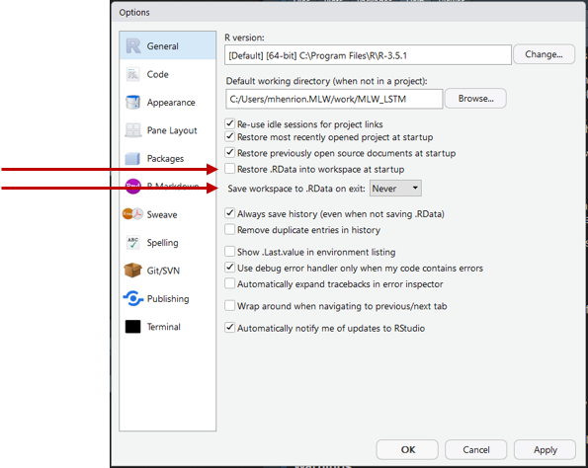
R basics: workspace

Slide 82
R basics: workspace
Save all objects in memory:
save(list=ls(),file="Session3_output/workspaceSave.RData")
Recover the workspace:
load(file="Session3_output/workspaceSave.RData")
Save history of all commands commands typed during session:
savehistory(file="Session3_output/Rcommands.Rhistory")

Slide 83
Writing R functions

Slide 84
R basics: functions
If you find yourself repeating the same commands over and over: you need to write a function
myFunction<-function(argument1,argument2,...){ ... }

Slide 85
R basics: functions
Rather than do this
mean(var1); sd(var1) quantile(var1,probs=c(0.5,0.25,0.75)); sum(!is.na(var1)) mean(var2); sd(var2) quantile(var2,probs=c(0.5,0.25,0.75)); sum(!is.na(var2)) mean(var3); sd(var3) quantile(var3,probs=c(0.5,0.25,0.75)); sum(!is.na(var3))
Write a function:
sumStatsContVars<-function(x,na.rm=T,...){ m<-mean(x,na.rm=na.rm) s<-sd(x,na.rm=na.rm) q<-quantile(x,na.rm=na.rm,...) n<-sum(!is.na(x)) return(c(m,s,q,n)) }

Slide 86
R basics: functions
Example
# create data matrix X<-matrix(cbind(rnorm(100), rexp(100), rchisq(100,df=1), rbeta(100,shape1=0.5,shape2=0.5), runif(100)), nrow=100, byrow=F, dimnames=list(NULL,c("x","y","z","w","v"))) # randomly set some values to missing X[sample(1:length(X),size=50)]<-NA # compute summary statistics using custom function sumStats<-t(apply(FUN=sumStatsContVars,X=X,MARGIN=2,probs=c(0.5,0.25,0.75))) cnames<-c("mean","sd","median","p25","p75","n") colnames(sumStats)<-cnames # print results print(sumStats)
## mean sd median p25 p75 n ## x 0.03176933 1.0721218 -0.04663112 -0.64087784 0.7366927 91 ## y 1.03160050 0.8171801 0.82831482 0.39813309 1.3270097 92 ## z 1.13065914 1.7576028 0.51333275 0.09230272 1.3621258 90 ## w 0.46260460 0.3472026 0.42970065 0.12358705 0.8479192 90 ## v 0.53362439 0.2742346 0.55170337 0.33459558 0.7557157 87

Slide 87
R scripts, editors, version control

Slide 88
R scripts
Use the console for experimenting / trying things out / exploring.
For your analyses / graphs: write R scripts
These are just text files containing your R code.
You can easily re-run everything $→$ reproducibility.
Save custom R functions to scripts that you can source() in other scripts.
Collaborate with others by sharing scripts.
If sharing scripts with others: comment your scripts.
# this is a comment explaining what the chunk of code does

Slide 89
Editors
R Studio comes with an editor: upper left panel.
Other editors:
Any text editor will do (but not word processors like MS Word!).
Notepad++
If you have access to UNIX-like terminals:
Emacs
Vi / Vim
Nano

Slide 90
Version control
You may change your mind about some code much later after it was written and want to recover a previous version.
You have updated a script, but a reviewer forces you to redo something the way you did it at submission. This is important for reproducible science.
Can be catastrophic if you do not have some kind of version control.
You can do manual version control by e.g. dating scripts.
Better: Git & GitHub (www.github.com)

Slide 91
R Markdown & reproducible science

Slide 92
Reproducible science
Share / publish your code.
Public GitHub repository can be one way of doing this.
Supplementary material submitted together with manuscript is another.
Research compendia: e.g. https://github.com/petermacp/BlantyreTBEpi
R Markdown provides a nice way of sharing reports together with code:
Fully integrated with R Studio.
Output formats: html, pdf, Word, PowerPoint, …
library(rmarkdown) # part of tidyverse
These slides were generated with R Markdown.
Markdown code uploaded to course GitHub repository.

Slide 93
[end of Session 3]

